Slide 1

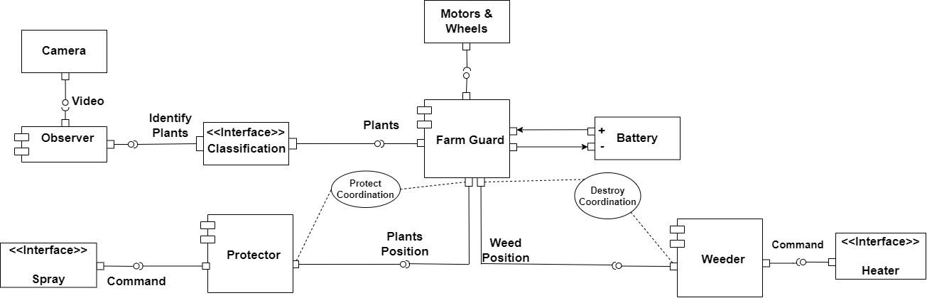
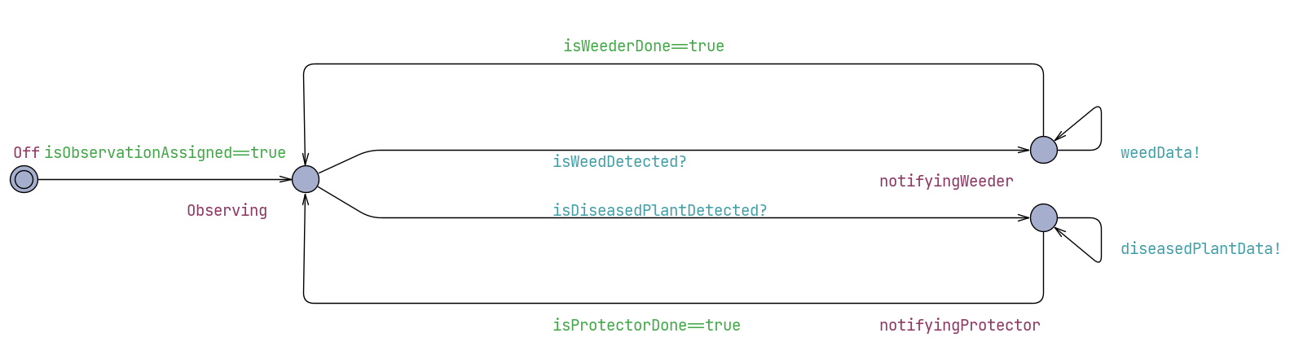
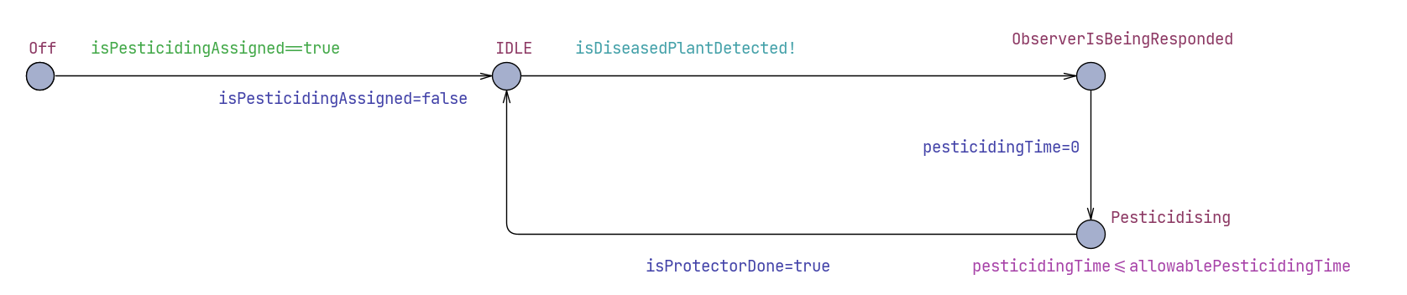
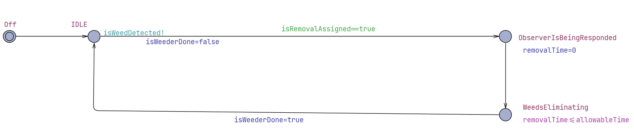
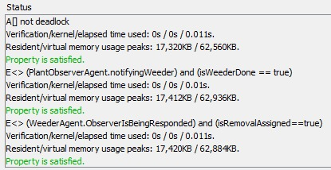
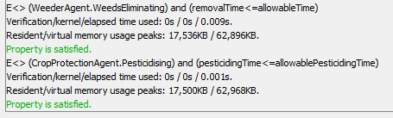

Group 3
Tao Zhao
Ali Beiti Aydenlou
Ferhad Gulizada
Negin Amiri
Danial Rafiee
Farm Guard
Mechatronic UML
Summer School
Embedded Systems Engineering
Components
RTSC
UPPAAL Software
RTSC of crop observer
RTSC of weeder
RTSC of crop protector

